Slide 1
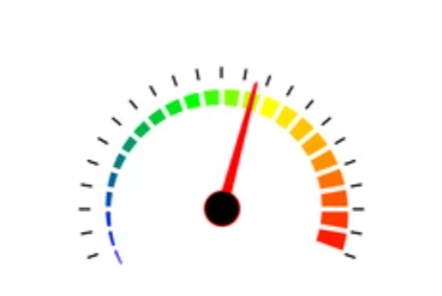
Optimization Techniques
Integer Programming
&
Dynamic Programming
Presented By :
Khagaraj Paneru (04)
Dharmemdra Thapa (29)

Slide 2
Topics
Optimization Technique
Objective Function
Decision Variable
Integer Programming
Dynamic Programming

Slide 3
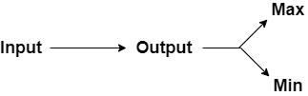
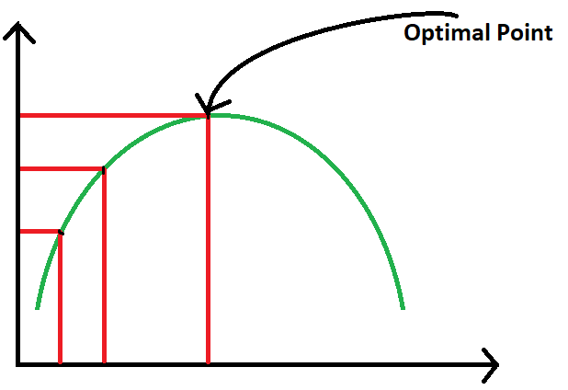
What is optimization technique ?
Consists of maximizing or minimizing a real function by systematically choosing input values from with in an allowed set and computing the value of the function.

Slide 4
Objective function and Decision variables
It is a value we need to optimize.
The value that optimizer can change.
max f(x) = a x₁ + b x₂
For example,
b
b
l
l
Area = l * b

Slide 5
Integer Programming Problem (IPP)
In linear programming problem, we observe that each decision variables, can take any real or fractional value.
For example,
max Z = 2x₁ – x₂ + x₃
s.t x₁ + 3x₂ – 2x₃ >= 3
x₁ - 5x₂ <= 4
x₁ , x₂ , x₃ >= 0
But there are some situation in which fractional values of these variables has no significance

Slide 6
Integer Programming Problem (IPP) Cont……
For example,
A furniture dealer deals in two items, tables and chairs. He has Rs 10,000 to invest and a space to store almost 50 pieces. A table cost him Rs 500 and a chair of Rs 200. He can sell a table at profit of 50 Rs and a chair at a profit of Rs 15. Assume that he can sell all the items that he buys. Formulate the problem as an LPP, so that he can maximize the profit.
Here , the mathematical model of the given IPP is -
max Z = 50x₁ – 15x₂
s.t 500x₁ + 200x₂ <= 10000
x₁ + x₂ <= 50
x₁ , x₂ >= 0 and are integer

Slide 7
Integer Programming Problem (IPP) Cont……
Definition :
Integer programming problem is those in which some or all of the variables are restricted to integers or discrete values.

Slide 8
What happen if we ignore IPP ?
Optimal solution is
Consider a simple problem
max Z = 5x₁ + 2x₂
s.t 3x₁ + 4x₂ <= 8
x₁ , x₂ >= 0
and are integer
X₁ = 8/3 , x₂ = 0 , max Z = 40/3
X₁ = 8/3
2
3
X₁ = 2 , x₂ = 0 ,
max Z = 10
X₁ = 3 , x₂ = 0 ,
max Z = 15

Slide 9
Types of IPP
There are basically three types of integer programming problem -
Pure Integer LPP
Mixed Integer LPP
Zero-One Integer LPP

Slide 10
Dynamic Programming
Dynamic Programming is technique which used to find the optimal solution of the problem. It is s both a mathematical optimization method and a computer programming method.
Max Z = C₁ X₁ +C₂ X₂
Such that c₁ x₁ +c₂ x₂ +…… ≤ b₁
c₁ x₁ + c₂ x₂ +…… ≤ b₂
.
.
.
x₁ , x₂, ….. ≥ 0
Above problem is Linear Programming Problem(LPP) where x₁ ,x₂,…… are variable which is called stage. c₁ and c₂,……. are constraints which is know as state. Z max be the object function. Where b₁ and b₂ are the resources. Then frame function is,
F_{i} (b₁ , b₂ )
i -> stage
In general
F_{i} (b₁ , b₂)= Max ∑ C_{i} X_{i} where i=1,2,…,n
0 ≤ X_{i} ≤ b
Where
b=> Min{ (b₁ / c_{i} x_{i}), (b₂ / c_{i} x_{i}) }

Slide 11
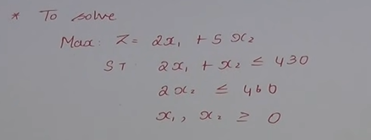
Solve LPP using Dynamic Programming

Slide 12
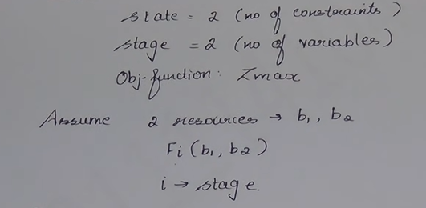
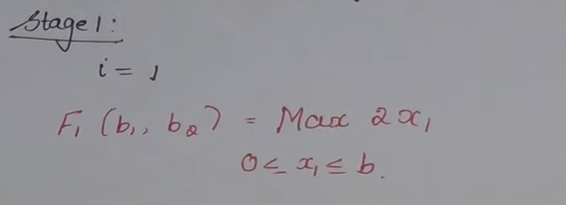
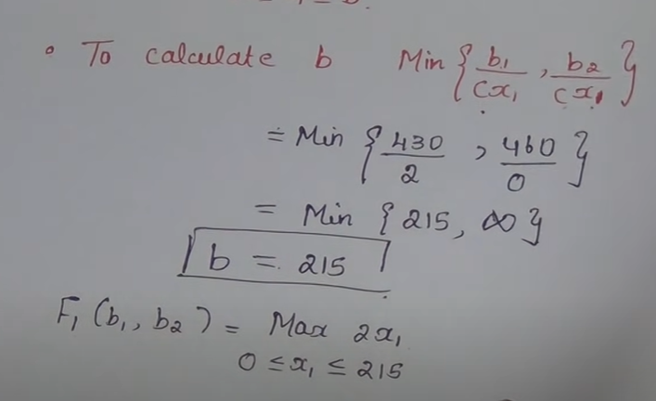
Solution

Slide 13
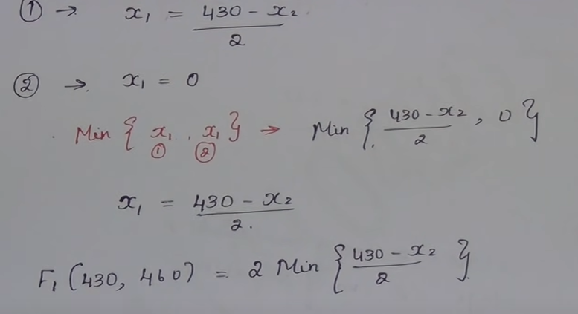
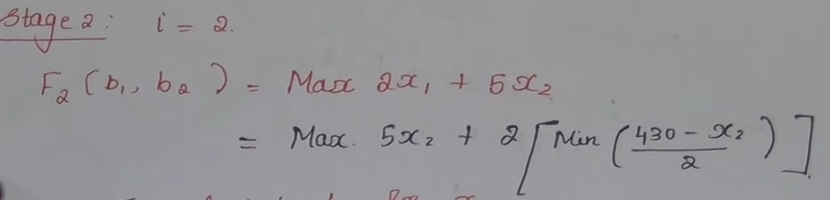
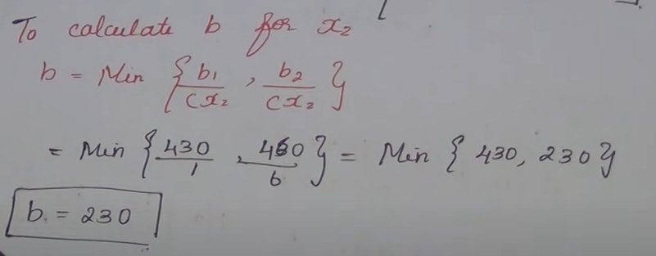

Slide 14
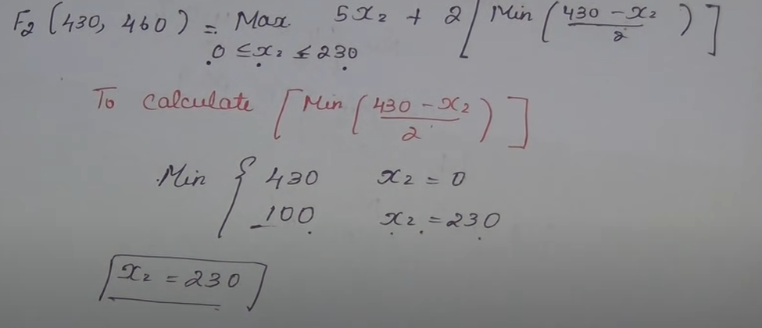
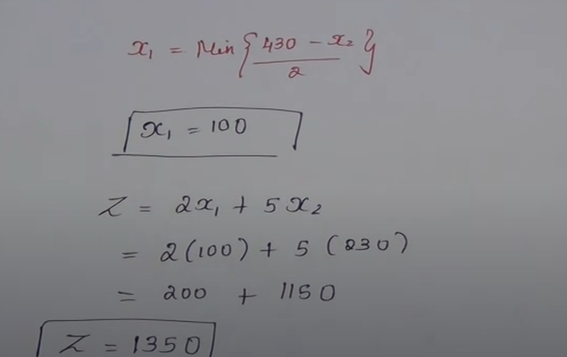

Slide 15


